Slide 1
Chapter 4

Slide 2
Definitions, Characteristics, and Benefits
Simply defined, data mining is a term used to describe discovering or “mining” knowledge from large amounts of data.
When considered by analogy, one can easily realize that the term data mining is a misnomer; that is, mining of gold from within rocks or dirt is referred to as “gold” mining rather than “rock” or “dirt” mining. Therefore, data mining perhaps should have been named “knowledge mining” or “knowledge discovery.”
Despite the mismatch between the term and its meaning, data mining has become the choice of the community. Many other names that are associated with data mining include knowledge extraction, pattern analysis, data archaeology, information harvesting, pattern searching, and data dredging.

Slide 3
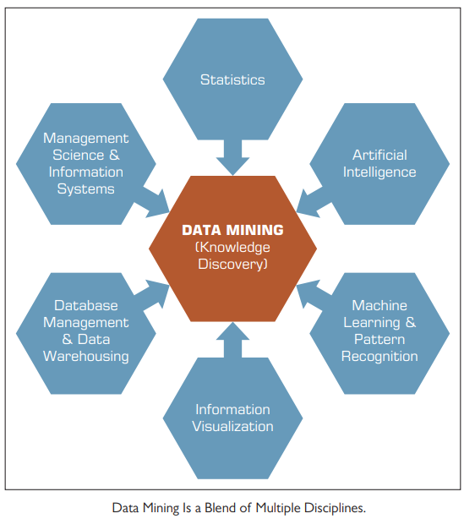
Technically speaking, data mining is a process that uses statistical, mathematical, and artificial intelligence techniques to extract and identify useful information and subsequent knowledge (or patterns) from large sets of data.
These patterns can be in the form of business rules, affinities, correlations, trends, or prediction models.

Slide 4
The following are the major characteristics and objectives of data mining:
- Data are often buried (conceal) deep within very large databases, which sometimes contain data from several years. In many cases, the data are cleansed and consolidated into a data warehouse.
- The data mining environment is usually a client/server architecture or a Web-based IS architecture.
- Sophisticated new tools, including advanced visualization tools, help to remove the information ore buried in corporate files or archival public records.
- The miner is often an end user, empowered by data drills and other powerful query tools to ask ad hoc questions and obtain answers quickly, with little or no programming skill.

Slide 5
- Striking it rich often involves finding an unexpected result and requires end users to think creatively throughout the process, including the interpretation of the findings
- Data mining tools are readily combined with spreadsheets and other software development tools.
- Because of the large amounts of data and massive search efforts, it is sometimes necessary to use parallel processing for data mining.

Slide 6
In general, data mining seeks to identify four major types of patterns:
1. Associations find the commonly co-occurring groupings of things, such as beer and diapers going together in market-basket analysis.
2. Predictions tell the nature of future occurrences of certain events based on what has happened in the past, such as predicting the winner of the Super Bowl or forecasting the absolute temperature of a particular day.
3. Clusters identify natural groupings of things based on their known characteristics, such as assigning customers in different segments based on their demographics and past purchase behaviors.
4. Sequential relationships discover time-ordered events, such as predicting that an existing banking customer who already has a checking account will open a savings account followed by an investment account within a year.

Slide 7
Generally speaking, data mining tasks can be classified into three main categories:
- prediction, association, and clustering
Based on the way in which the patterns are extracted from the historical data, the learning algorithms of data mining methods can be classified as either supervised or unsupervised.
→ With supervised learning algorithms:
the training data includes both the descriptive attributes (i.e., independent variables or decision variables) as well as the class attribute (i.e., output variable or result variable).
→ With unsupervised learning algorithms:
the training data includes only the descriptive attributes.

Slide 8
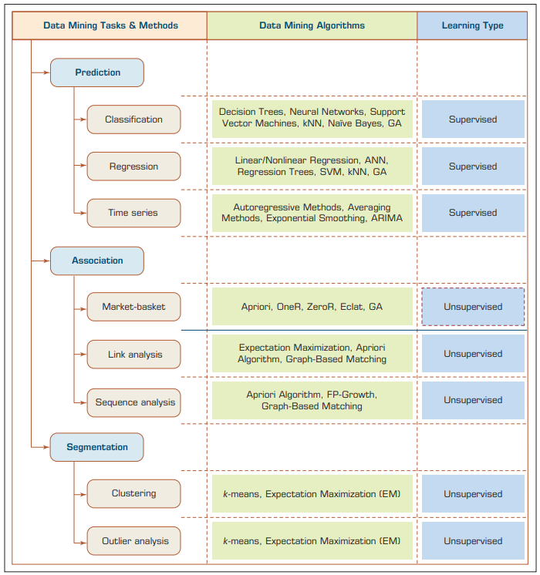
A Simple Taxonomy for Data Mining Tasks, Methods, and Algorithms
Read each part from book, (basic understanding)
** Need ML BooK

Slide 9
4.3 Data Mining Applications
Customer relationship management
Banking
Retailing and logistics
Manufacturing and production
Brokerage and securities trading
Insurance
Computer hardware and software.
Government and defense.
Travel industry (airlines, hotels/resorts, rental car companies).
Healthcare
Medicine
Entertainment industry.
Sports

Slide 10
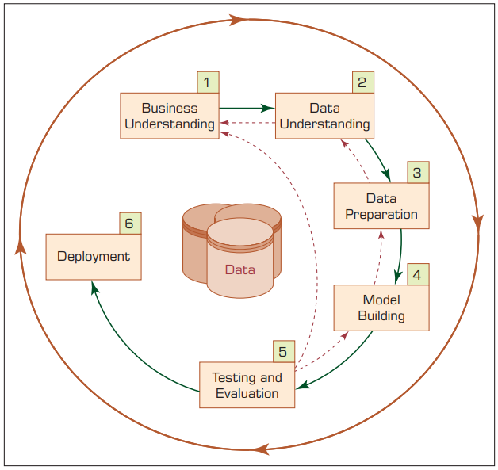
4.4 Data Mining Process
There are six steps:
Step 1: Business Understanding.
The key element of any data mining study is to know what the study is for. Answering such a question begins with a thorough understanding of the managerial need for new knowledge and an explicit specification of the business objective regarding the study to be conducted.
Specific goals such as:
“What are the common characteristics of the customers we have lost to our competitors recently?” or
“What are typical profiles of our customers, and how much value does each of them provide to us?”

Slide 11
Step 2: Data Understanding.
A data mining study is specific to addressing a well-defined business task, and different business tasks require different sets of data. Following the business understanding, the main activity of the data mining process is to identify the relevant data from many available databases. Some key points must be considered in the data identification and selection phase.

Slide 12
For example, a retail data mining project may seek to identify spending behaviors of female shoppers who purchase seasonal clothes based on their demographics, credit card transactions, and socioeconomic attributes.
Furthermore, the analyst should build an intimate understanding of the data sources.
- Where the relevant data are stored and in what form;
- What the process of collecting the data is—automated versus manual;
Who the collectors of the data are and how often the data are updated) and the variables (e.g., What are the most relevant variables?
Are there any synonymous (identical) and/or homonymous variables?
Are the variables independent of each other—do they stand as a complete information source without overlapping or conflicting information?).

Slide 13
Step 3: Data Preparation
The purpose of data preparation (more commonly called data preprocessing) is to take the data identified in the previous step and prepare it for analysis by data mining methods. Compared to the other steps in CRISP-DM, data preprocessing consumes the most time and effort; most believe that this step accounts for roughly 80% of the total time spent on a data mining project.
The reason for such an enormous effort spent on this step is the fact that real-world data is generally incomplete (lacking attribute values, lacking certain attributes of interest, or containing only aggregate data), noisy (containing errors or outliers), and inconsistent (containing discrepancies in codes or names).

Slide 14
Step 4: Model Building
In this step, various modeling techniques are selected and applied to an already prepared data set to address the specific business need. The model-building step also encompasses the assessment and comparative analysis of the various models built.
Because there is not a universally known best method or algorithm for a data mining task, one should use a variety of viable model types along with a well-defined experimentation and assessment strategy to identify the “best” method for a given purpose.

Slide 15
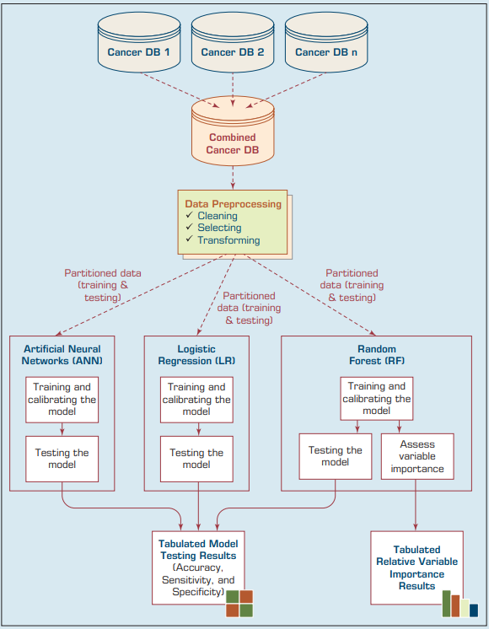
A Data Mining Methodology for Investigation of Comorbidity in Cancer Survivability

Slide 16
Step 5: Testing and Evaluation
In step 5, the developed models are assessed and evaluated for their accuracy and generality. This step assesses the degree to which the selected model (or models) meets the business objectives and, if so, to what extent (i.e., Do more models need to be developed and assessed?).
Another option is to test the developed model(s) in a real-world scenario if time and budget constraints permit

Slide 17
Step 6: Deployment
Development and assessment of the models is not the end of the data mining project. Even if the purpose of the model is to have a simple exploration of the data, the knowledge gained from such exploration will need to be organized and presented in a way that the end user can understand and benefit from.
The deployment step may also include maintenance activities for the deployed models. Because everything about the business is constantly changing, the data that reflect the business activities also are changing.

Slide 18
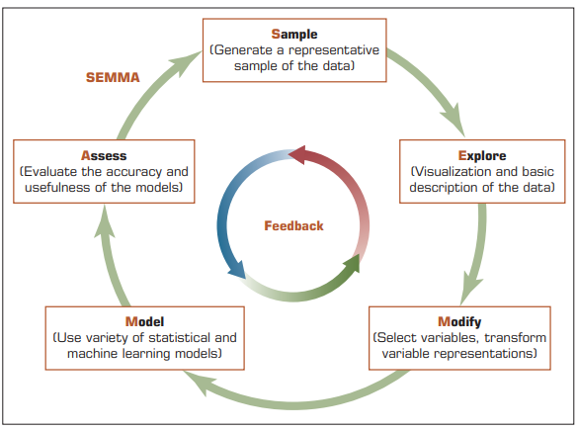
Other Data Mining Standardized Processes
and Methodologies
SEMMA Data Mining Process

Slide 19
Short Notes on KDD
Some practitioners commonly use the term knowledge discovery in databases (KDD) as a synonym for data mining. Fayyad et al. (1996) defined knowledge discovery in databases as a process of using data mining methods to find useful information and patterns in the data, as opposed to data mining, which involves using algorithms to identify patterns in data derived through the KDD process.
KDD is a comprehensive process that encompasses data mining. The input to the KDD process consists of organizational data.
The enterprise data warehouse enables KDD to be implemented efficiently because it provides a single source for data to be mined.
Dunham (2003) summarized the KDD process as consisting of the following steps: data selection, data preprocessing, data transformation, data mining, and interpretation/ evaluation.

Slide 20
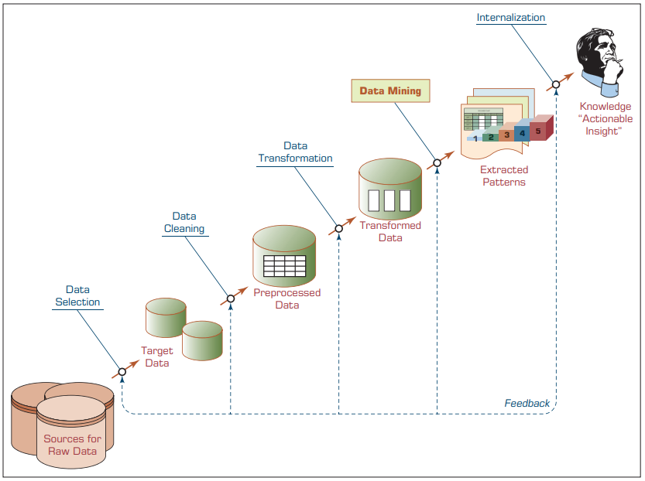
KDD (Knowledge
Discovery
in Databases)
Process

Slide 21
4.5 Data Mining Methods
A variety of methods are available for performing data mining studies, including classification, regression, clustering, and association.
Most data mining software tools employ more than one technique (or algorithm) for each of these methods.

Slide 22
Classification
Classification is perhaps the most frequently used data mining method for real-world problems. As a popular member of the machine-learning family of techniques, classification learns patterns from past data (a set of information—traits, variables, features—on characteristics of the previously labeled items, objects, or events) to place new instances (with unknown labels) into their respective groups or classes.

Slide 23
For example,
One could use classification to predict whether the weather on a particular day will be “sunny,” “rainy,” or “cloudy.”
Popular classification tasks include credit approval (i.e., good or bad credit risk), store location (e.g., good, moderate, bad), target marketing (e.g., likely customer, no hope), fraud detection (i.e., yes/no), and telecommunication (e.g., likely to turn to another phone company, yes/no).
** Imp. Note.
If what is being predicted is a class label (e.g., “sunny,” “rainy,” or “cloudy”), the prediction problem is called a classification, whereas if it is a numeric value (e.g., temperature, such as 68°F), the prediction problem is called a regression.

Slide 24
What is key difference between clustering and classification?
Clustering (data mining method) can also be used to determine groups (or class memberships) of things, there is a significant difference between the classification and clustering.
Classification learns the function between the characteristics of things (i.e., independent variables) and their membership (i.e., output variable) through a supervised learning process where both types (input and output) of variables are presented to the algorithm.
In clustering, the membership of the objects is learned through an unsupervised learning process where only the input variables are presented to the algorithm.
Unlike classification, clustering does not have a supervising (or controlling) mechanism that enforces the learning process;
Instead, clustering algorithms use one or more heuristics (e.g., multidimensional distance measure) to discover natural groupings of objects.

Slide 25
supervised versus unsupervised learning
(Study at HOME)

Slide 26
The most common two-step methodology of classification-type:
Prediction involves model development/training
and model testing/deployment
In the model development phase, a collection of input data, including the actual class labels, is used (training model).
After a model has been trained, the model is tested against the holdout sample for accuracy assessment and eventually deployed for actual use where it is to predict classes of new data instances (where the class label is unknown).
Several factors are considered in assessing the model, including the following:
- Predictive accuracy
- Speed
- Robustness
- Scalability
- Interpretability

Slide 27
- Predictive accuracy
The model’s ability to correctly predict the class label of new or previously unseen data.
Prediction accuracy is the most commonly used assessment factor for classification models.
To compute this measure, actual class labels of a test data set are matched against the class labels predicted by the model.
The accuracy can then be computed as the accuracy rate, which is the percentage of test data set samples correctly classified by the model.

Slide 28
• Speed.
The computational costs involved in generating and using the model, where faster is deemed to be better.
• Robustness.
The model’s ability to make reasonably accurate predictions, given noisy data or data with missing and erroneous values.
• Scalability.
The ability to construct a prediction model efficiently given a rather large amount of data.
• Interpretability.
The level of understanding and insight provided by the model (e.g., how and/or what the model concludes on certain predictions).

Slide 29
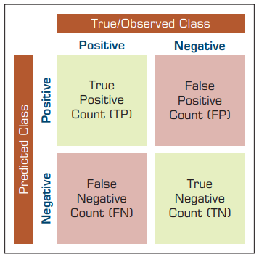
Estimating:
The True Accuracy of Classification Models
In classification problems, the primary source for accuracy estimation is the confusion matrix (also called a classification matrix or a contingency table).
The given figure shows a confusion matrix for a two-class classification problem. The numbers along the diagonal from the upper left to the lower right represent correct decisions, and the numbers outside this diagonal represent the errors.
A Simple Confusion Matrix for Tabulation of Two-Class Classification Results

Slide 30
Understanding the Confusion Matrix in Machine Learning - GeeksforGeeks

